Slide 1
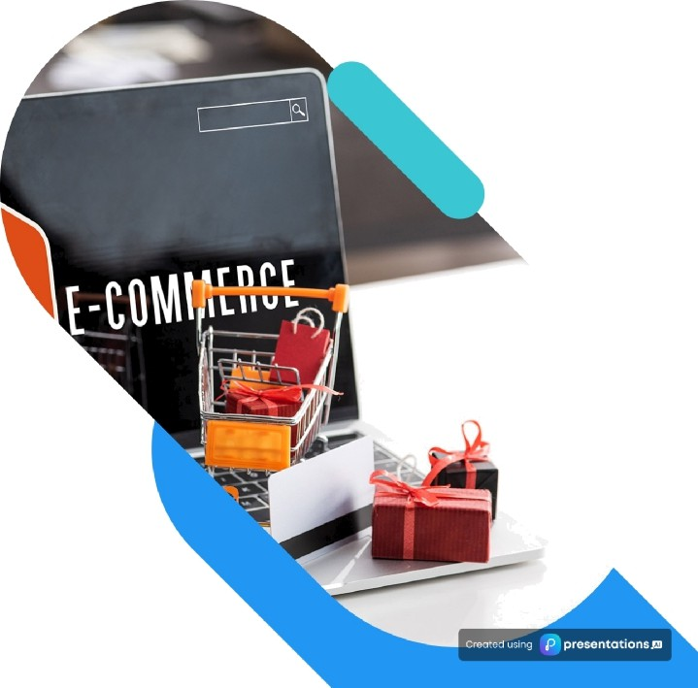
E—commerce Website
using MERN Stack
A comprehensive guide to leveraging the MERN stack for e-commerce solutions, focusing on benefits and real-world applications.

Slide 2

The MERN Stack Overview
Understanding the Core Technologies for E-commerce Development
MERN Stack Essentials
e
MongoDB for Data Management
A NoSQL database that offers flexibility in data storage, making it ideal for e-commerce applications with varying data structures.
e
Express.js for Server Logic
A web framework for Node.js that simplifies server-side logic, enabling efficient handling of web requests and responses.
e
React.js for User Interfaces
A powerful JavaScript library that allows developers to build dynamic and responsive user interfaces, enhancing user experience.
Node.js for Backend Development
A JavaScript runtime that facilitates server-side programming, enabling the creation of scalable applications tailored for e—commerce.
^œn'ea 1°nç preseutotions

Slide 3
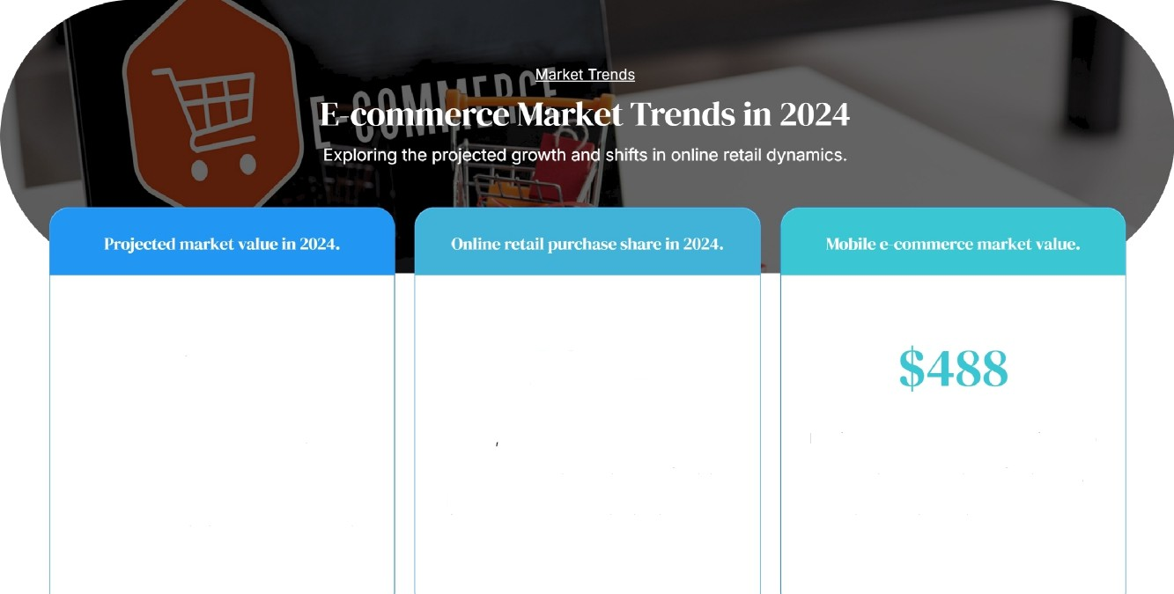

$6.3
20» o
In 2024 20.1% of total retail purchases are expected to occur online, indicating a shift in consumer shopping habits towards digital platforms. This percentage is projected to rise to 22.6% by 2027, highlighting a long- term trend.
The global e-commerce market is set to grow to $6.3 trillion, reflecting a significant increase from $5.8 trillion in 2023. This growth underscores the expansion of digital commerce and its impact on global retail.
Mobile e—commerce sales are projected to reach $488 billion, accounting for 42.9% of total online sales. This emphasizes the growing significance of mobile-friendly shopping experiences in the e-commerce landscape.

Slide 4







Key Features of MERN Stack for E commerce
Exploring the Unique Advantages for E-commerce Development
MERN Sta ck Benefits
¡e Pcrf‹›rnïaiłcc
The MERN stack can efficiently manage increased traffic, ensuring your site remains responsive as demand grows.
With its high-speed operations, the MERN stack delivers fast and responsive user experiences that enhance customer satisfaction.
The stack allows for easy adjustments to meet evolving business needs, making it a long-term solution for e- commerce.
A robust ecosystem provides access to numerous libraries and tools, facilitating quicker development and problem- solving.
^œn'ea 1°nç preseutotions

Slide 5

Pr‹›ject A: linliiae firucery Sers"ice
This platform streamlined product viewing and purchasing, enhancing user
experience and sales.
E-commerceSuccess
Case Studies: Successful E—commerce Implementations
Exploring the Impact of the MERN Stack on E-
commerce Platforms
Pr‹›ject B: Fashion E-commerce Site
Utilizes third-party APis for improved functionality, offering customers a rich shopping experience.
f/Iient Neeils .liliiresseil
Both projects effectively met specific client requirements, demonstrating versatility in the MERN stack.
flrii'ing Business Success
These implementations led to increased sales and customer satisfaction, validating the MERN stack's effectiveness.
’œn'eó'1°nç preseutotions

Slide 6
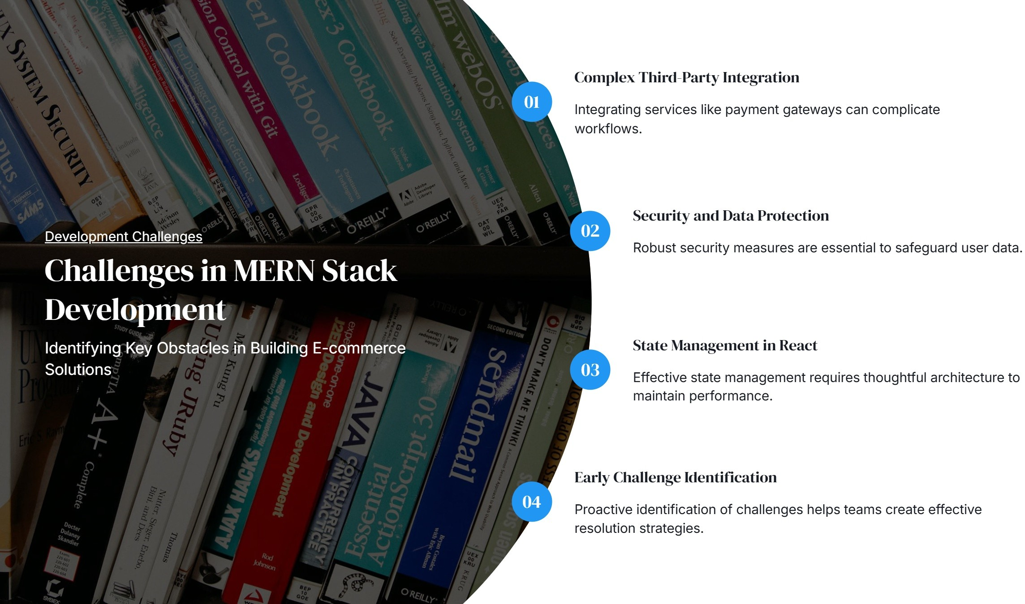


Slide 7




Solutions to Development Challenges
Effective Strategies for MERN Stack E-commerce Development
Develop ment Solutions
Utilize Reiiux for State Manai;ement
Implementing Redux simplifies the management of application state, enhancing predictability and debugging.
Let erage f\ommunity StiPp‹›rt
Engaging with community forums and documentation can provide solutions to common integration
challenges.
lilolat Security Best Practices
Incorporate HTTPS and data encryption to safeguard user data, building trust in your e-commerce platform.
^œn'ea 1°nç preseutotions

Slide 8







Establishment of the first ct /ummerce corrlpany.
The inception of e-commerce began with the establishment of the first online company, marking the start of digital commerce.
First online transaction takes }ilace.
This year marked a pivotal moment with the first online sale, paving the way for future transactions.
Amazon's rise in the 2000s transformed the online shopping experience, setting new standards in e- commerce.
mobile commerce gains traction.
The proliferation of smartphones led to the rise of mobile commerce, further expanding the reach of e- commerce.
Surge in e-commerce ilue t
, , , ,
,

Slide 9
Impact of Mobile E commerce
Exploring the growth and market potential of mobile e-commerce.
Pmjected share of mobile sales in 2024.
Market size of mobile e—commerce.
42.9
$488
Mobile e-commerce is anticipated to represent 42.9% of total online
The mobile e-commerce market is valued at ' 488 billion, showcasing
sales by 2024, indicating a significant shift in consumer purchasing its importance as a key driver in the overall e-commerce landscape.
behavior towards mobile devices.
c eased u › s
presentations ss

Slide 10


